Slide 1
Chapter Ten
Derivative Securities Markets
©McGraw Hill LLC. All rights reserved. No reproduction or distribution without the prior written consent of McGraw Hill.

Slide 2
Derivative Securities: Overview
A derivative security is an agreement between two parties to exchange a standard quantity of an asset at a predetermined price at a specified date in the future
  Payoff is linked to another, previously issued security
  As the value of the underlying security to be exchanged changes, the value of the derivative security changes
  Involves the transference of risk
Traders can experience large losses if the price of the underlying asset moves against them significantly
  At the heart of the recent financial crisis were losses associated with off-balance-sheet derivative securities created and held by FIs
Notes:
In 2003, former Federal Reserve Board chair Alan Greenspan credited the derivative securities markets with helping the banking system maintain its strength through the economic recession in the early 2000s.

Slide 3
Derivative Securities: Overview (Continued)
Derivative securities markets are those in which derivative securities trade
Growth in derivative securities markets has occurred mainly since the 1970s
  First of the modern wave of derivatives to trade were foreign currency futures contracts
  Second wave of derivative security growth was with interest rate derivative securities
  Third wave of innovations occurred in the 1990s and 2000s with credit derivatives (e.g., credit forwards, credit risk options, and credit swaps)
Rapid growth of derivatives has been controversial

Slide 4
Spot Markets
A spot contract is an agreement to transact involving the immediate exchange of assets and funds
  Unique feature of a spot market is the immediate and simultaneous exchange of cash for securities, or what is often called delivery versus payment
Spot transactions occur because the buyer of the assets believes its value will increase in the immediate future (over the investor’s holding period)
  If the value of the asset increases as expected, the investor can sell the asset at its higher price for a profit

Slide 5
Forward Markets:
Forward Contracts
A forward contract is an agreement to transact involving the future exchange of a set amount of assets at a set price
  Market participants take a position in forward contracts because the future (spot) price or interest rate on an asset is uncertain
  Can be based on a specified interest rate (e.g., SOFR) rather than a specified asset (called forward rate agreements)
  Often involve underlying assets that are nonstandardized, because the terms of the contract are negotiated individually between the buyer and seller

Slide 6
Forward Markets
Commercial banks, investment banks, and broker-dealers are the major forward market participants, acting as both principals and agents
  As of December 2021, U.S. commercial banks held over $31.1 trillion of forward contracts that were listed in OTC markets
Each forward contract is originally negotiated between the FI and the customer
  A risk of default (by either party) exists
  Recently, credit derivative instruments have been developed to better allow FIs to hedge credit risk
Advent of secondary market trading has resulted in an increase in the standardization of forward contracts

Slide 7
Futures Markets:
Futures Contracts
A futures contract is an agreement to transact involving the future exchange of a set amount of assets for a price that is settled daily
  Traded on an organized exchange
Very similar to a forward contract
  One difference is that the default risk on futures is significantly reduce by the futures exchange guaranteeing to indemnity counterparties against credit or default risk
  Another difference relates to the contract’s price, which in a future is marked to market daily
Unless a systematic financial market collapse threatens an exchange itself, futures are essentially risk-free

Slide 8
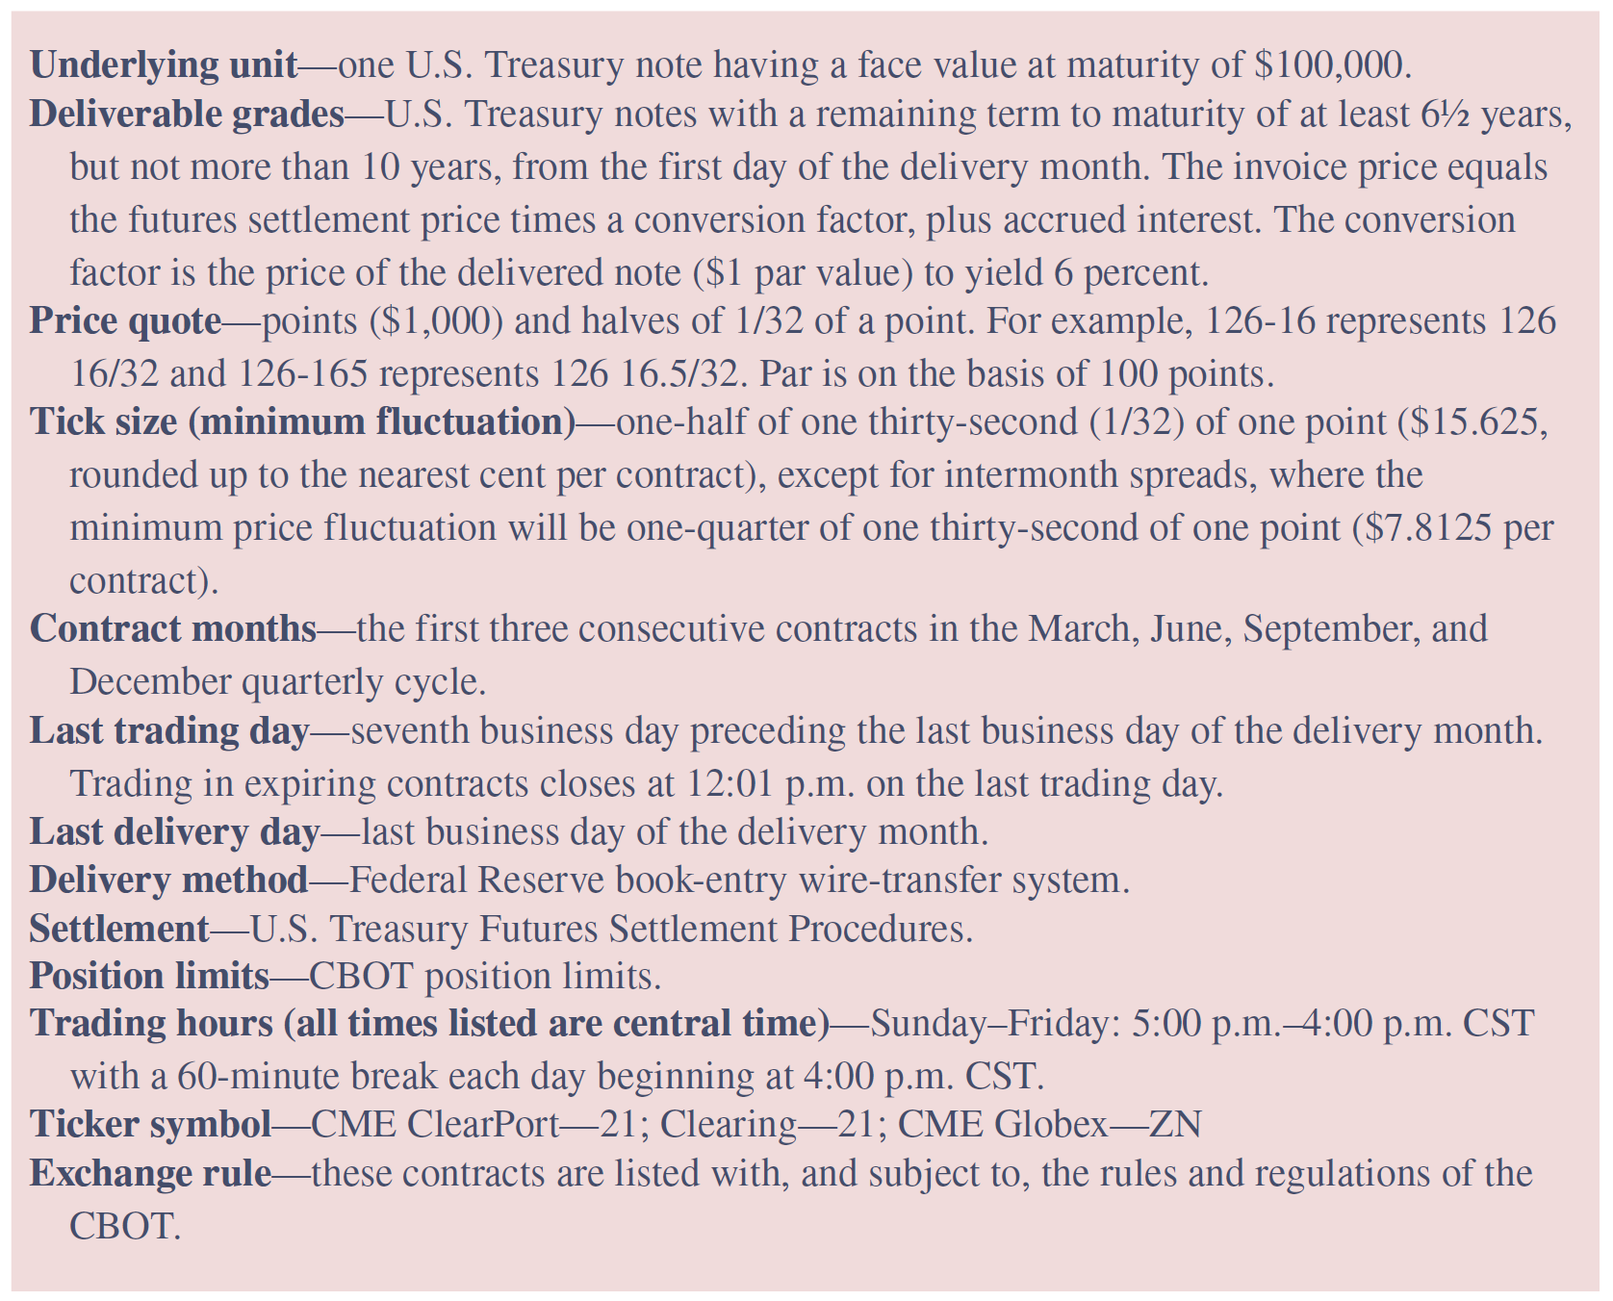
Contract Terms for 10-Year Treasury Note Futures
Notes:
The terms of futures contracts (e.g., contract size, delivery month, trading hours, minimum price fluctuation, daily price limits, and process used for delivery) traded in the United States are set by the exchange and are subject to the approval of the Commodity Futures Trading Commission (CFTC), the principal regulator of futures markets.
For example, the contract terms for 10-year T-note futures are listed in Table 10–3.

Slide 9
Futures Markets
Futures trading occurs on organized exchanges
  Chicago Board of Trade (CBOT) and the New York Mercantile Exchange (NYMEX), both of which are part of the CME Group
  Financial futures market trading was introduced in 1972
Most trading takes place in trading “pits” using an open-outcry auction method among exchange members
  Floor brokers place trades from the public, while professional traders trade for their own account
  Position traders take a position based on their expectations about the future direction of the prices of the underlying assets
  Day traders generally take a position within a day and liquidate it before day’s end, while scalpers take positions for very short periods of time (e.g., minutes)
Notes:
Futures contracts exist on commodity (e.g., corn, wheat), energy (e.g., electricity), metals (e.g., copper, gold), and other (e.g., weather) contracts as well.

Slide 10
Futures Markets (Continued)
Futures trades may be placed as market or limit orders
  Order may be for long position (the purchase of a futures contract) or short position (the sale of a futures contract)
Clearinghouse is the unit that oversees trading on the exchange and guarantees all trades made by the exchange traders
Holder of a futures contract has two choices for liquidating his or her position:
  Liquidate position before the futures contract expires
  Hold the futures contract to expiration
Traders in futures (as well as option) markets can be either speculators, hedgers, or arbitrageurs

Slide 11
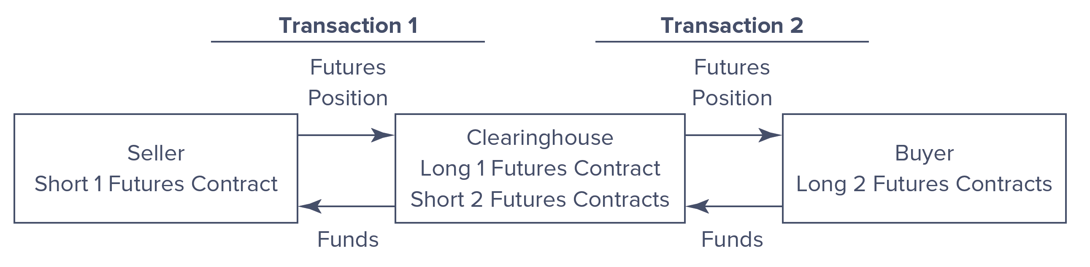
Clearinghouse Function in Futures Markets
Notes:
The clearinghouse breaks up every trade into a buy and sell transaction and takes the opposite side of the transaction, becoming the buyer for every futures contract seller and the seller for every futures contract buyer.

Slide 12
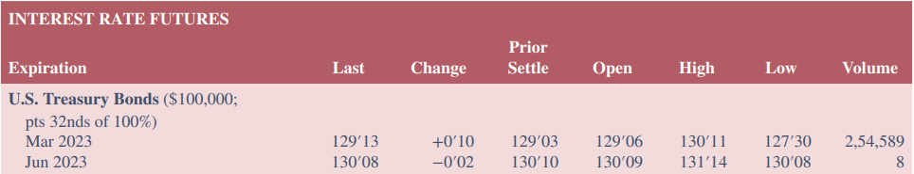
Profit and Loss on a Futures Transaction: Example
Table 10-4 (below) shows a June 2023 T-bond futures contract could be bought (long) or sold (short) on January 11, 2023, for 130’08 (or 130.25% of the face value of the T-bond)
Minimum contract size is $100,000, so a position in one contract can be taken at a price of $130,250
If the T-bond futures price falls to 129.87% of the face value between January 11, 2023 and the June expiration, the long position incurs a loss of $380 [(130.25% - 129.87%) x 100,000], while the short position incurs a gain of $380
Notes:
A long position in the futures market produces a profit when the value of the underlying T-bond increases (i.e., interest rates fall between January 11, 2023, and the June expiration). A short position in the futures will produce a profit when the value of the underlying T-bond decreases (i.e., interest rates rise).

Slide 13
Margin Requirements on Futures Contracts
Brokerage firms require customers to post only a portion of the value of the futures (and options) contracts, called an initial margin, any time they request a trade
  Amount of the margin varies according to type of contract traded and quantity of futures contracts traded
  If losses on the customer’s futures position occur and the level of the funds in the margin account drops below a stated level (i.e., maintenance margin), the customer receives a margin call
Futures are leveraged instruments, meaning traders post and maintain only a small portion of the value of their futures position in their accounts

Slide 14
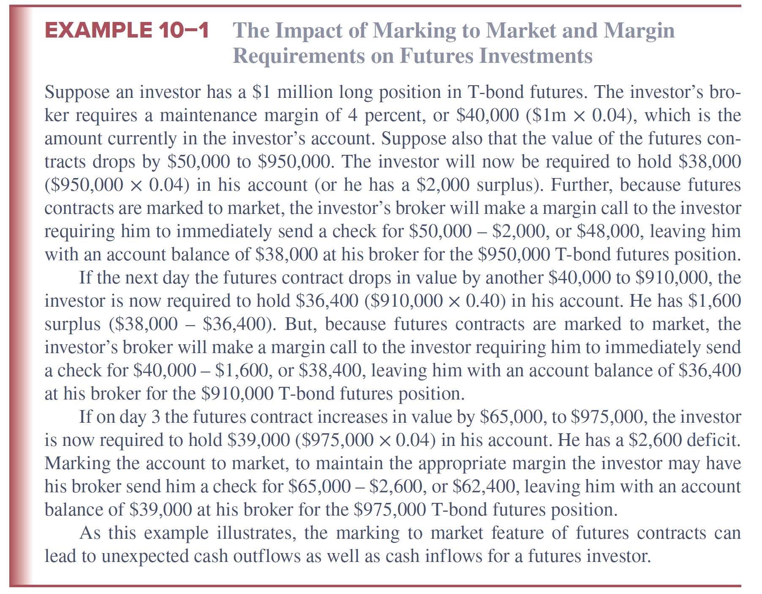
Impact of Marking to Market and Margin Requirements on Futures Investments

Slide 15
Options
An option is a contract that gives the holder the right, but not the obligation, to buy or sell the underlying asset at a specified price within a specified period of time
  Call option gives the purchaser (or buyer) the right to buy an underlying security (e.g., a stock) at a prespecified price called the exercise or strike price (X)
    In return, buyer of call option must pay the writer (or seller) an up-front fee known as a call premium (C)
  Put option gives the option buyer the right to sell an underlying security (e.g., a stock) at a prespecified price to the writer of the put option
    In return, the buyer of the put option must pay the writer (or seller) the put premium (P)

Slide 16
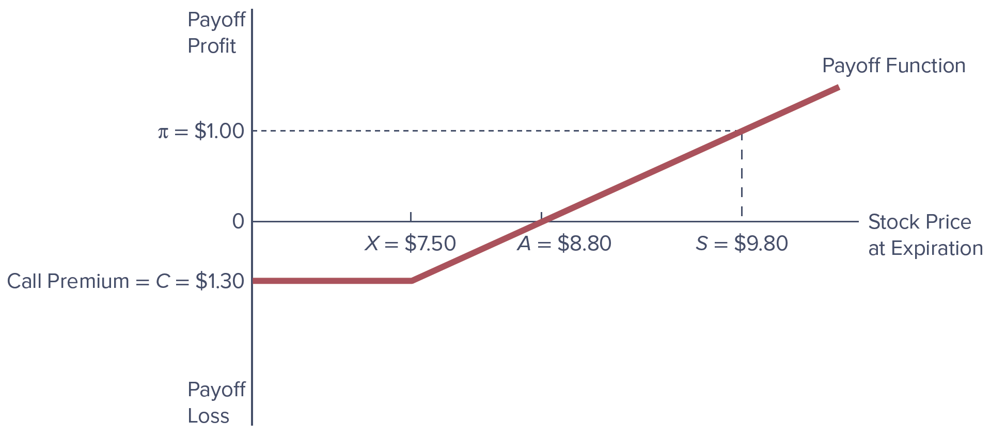
Buying a Call Option
Notes:
Buying a call option is an appropriate position when the underlying asset’s price is expected to rise.
As Figure 10–5 shows, if, as the option expires, the price of the stock underlying the option is S, the buyer makes a profit of π, which is the difference between the stock’s price (S, e.g., $9.80) and the exercise price of the option (X, e.g., $7.50) minus the call premium paid to the writer of the option (C, e.g., $1.30).
If the underlying stock’s price is A (i.e., $8.80) as the option expires, the buyer of the call has just broken even because the net proceeds from exercising the call (A – X = $8.80 – $7.50 = $1.30) just equal the premium payment for the call (C, or $1.30 in this case).

Slide 17
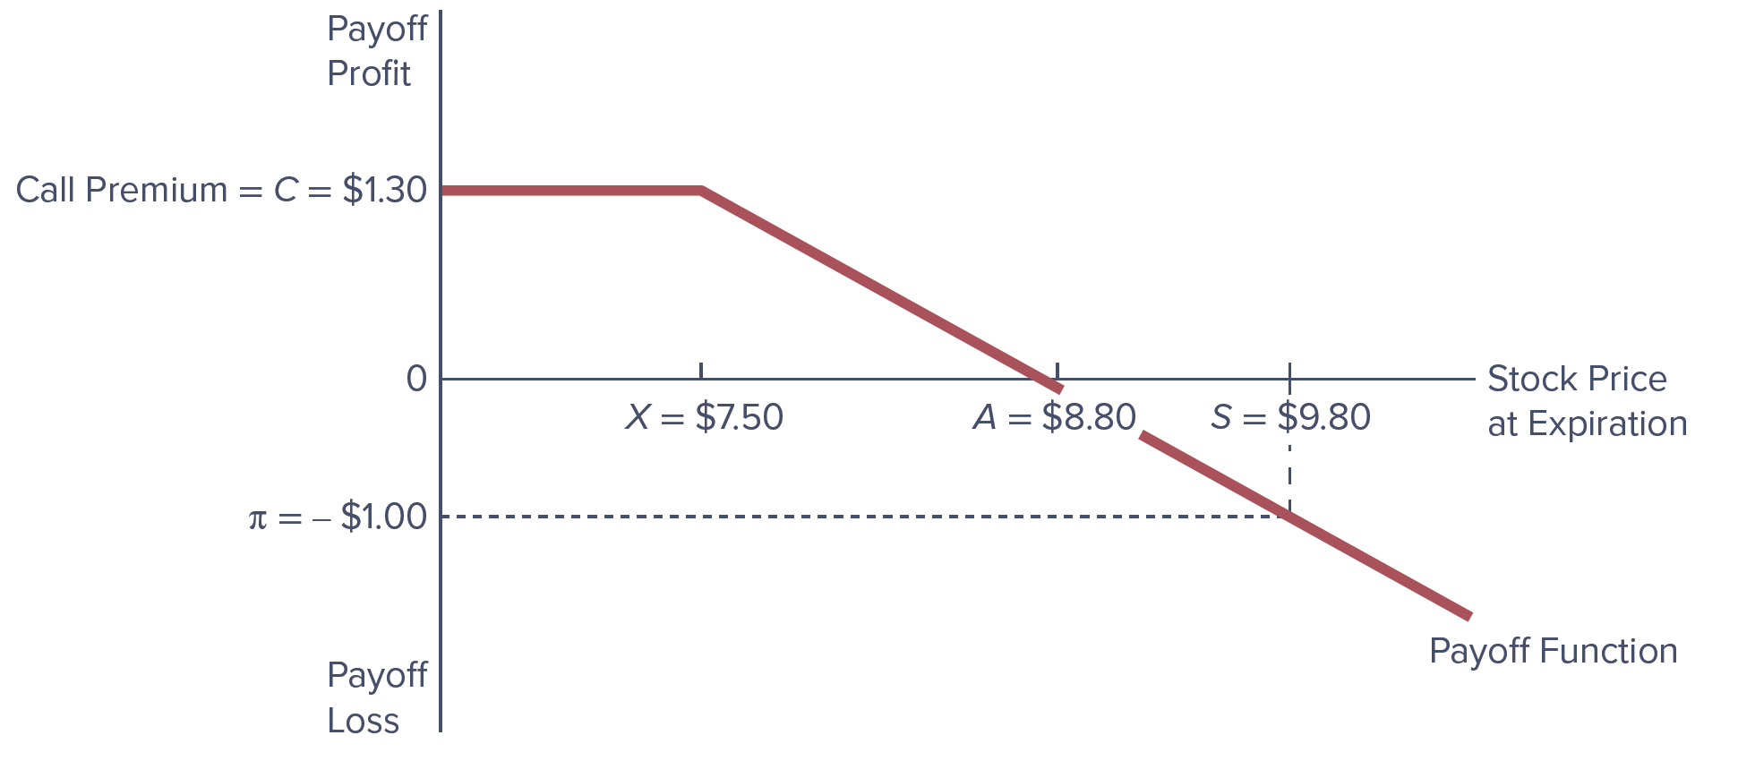
Writing a Call Option
Notes:
Writing a call option is an appropriate position when the underlying asset’s price is expected to fall.
The writer of a call option sells the option to the buyer (or is said to take a short position in the option). In writing a call option on a stock, the writer or seller receives an up-front fee or premium (C, e.g., $1.30) and must stand ready to sell the underlying stock to the purchaser of the option at the exercise price, X (e.g., $7.50).
Note the payoff from writing a call option on a stock in Figure 10–6.

Slide 18
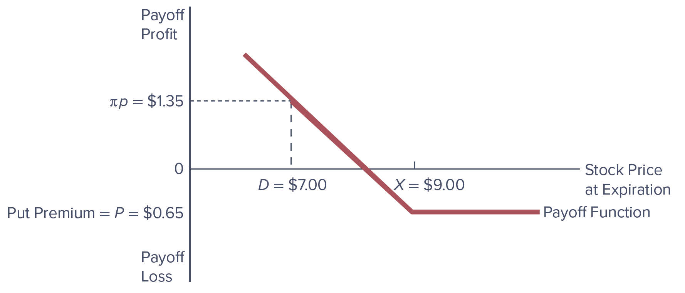
Buying a Put Option
Notes:
Buying a put option is an appropriate position when the price on the underlying asset is expected to fall.
The buyer of a put option on a stock has the right (but not the obligation) to sell the underlying stock to the writer of the option at an agreed upon exercise price (X, e.g., $9.00). In return for this option, the buyer of the put option pays a premium (P, e.g., $0.65) to the option writer.
We show the potential payoffs to the buyer of the put option in Figure 10–7.

Slide 19
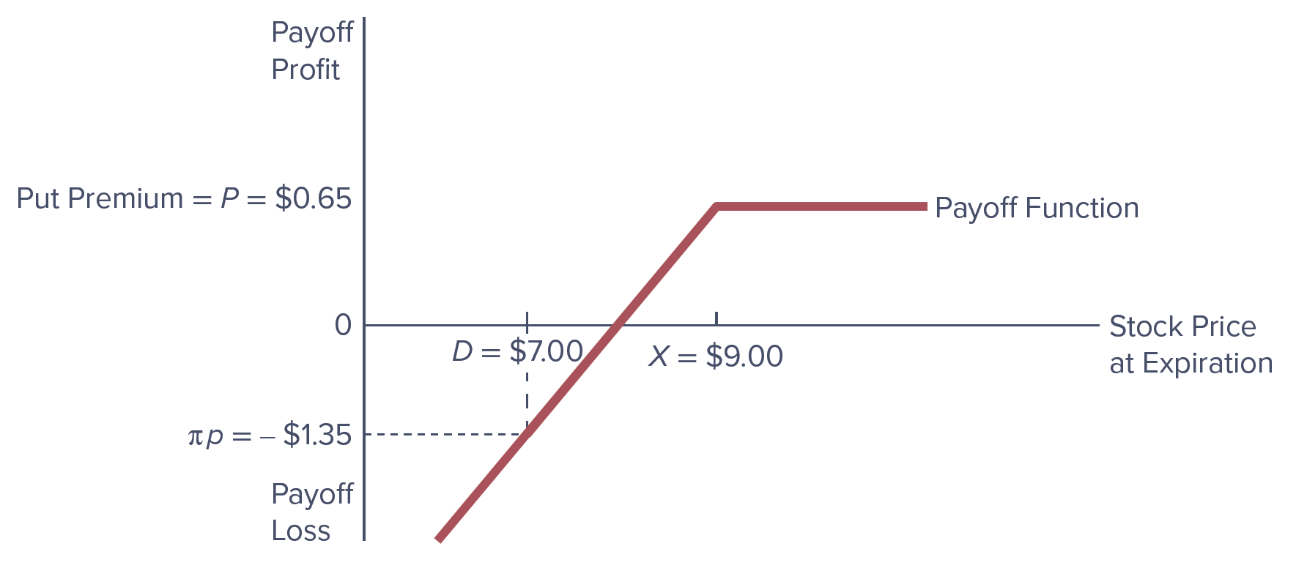
Writing a Put Option
Notes:
Writing a put option is an appropriate position if the price on the underlying asset is expected to rise.
The writer or seller of a put option receives a fee or premium (P, e.g., $0.65) in return for standing ready to buy the underlying stock at the exercise price (X, e.g., $9.00) should the buyer of the put choose to exercise the option.
See the payoff function for writing a put option on a stock in Figure 10–8.

Slide 20
Option Values
Model most commonly used to price and value options is the Black-Scholes pricing model
Black-Scholes model examines five factors that affect the price of an option:
  The spot price of the underlying asset
  The exercise price on the option
  The option’s exercise date
  Price volatility of the underlying asset
  The risk-free rate of interest
Time value of an option is the difference between an option’s price (or premium) and its intrinsic value
Notes:
An option’s intrinsic value is the difference between the exercise price and the underlying asset’s price.

Slide 21
Option Markets
The Chicago Board of Options Exchange (CBOE) opened in 1973
  First exchange devoted solely to the trading of stock options
  In 1982, financial futures options contracts started trading
An American option can be exercised at any time before (and on) the expiration date
A European option can be exercised only on the expiration date
The trading process for options is similar to that for futures contracts

Slide 22
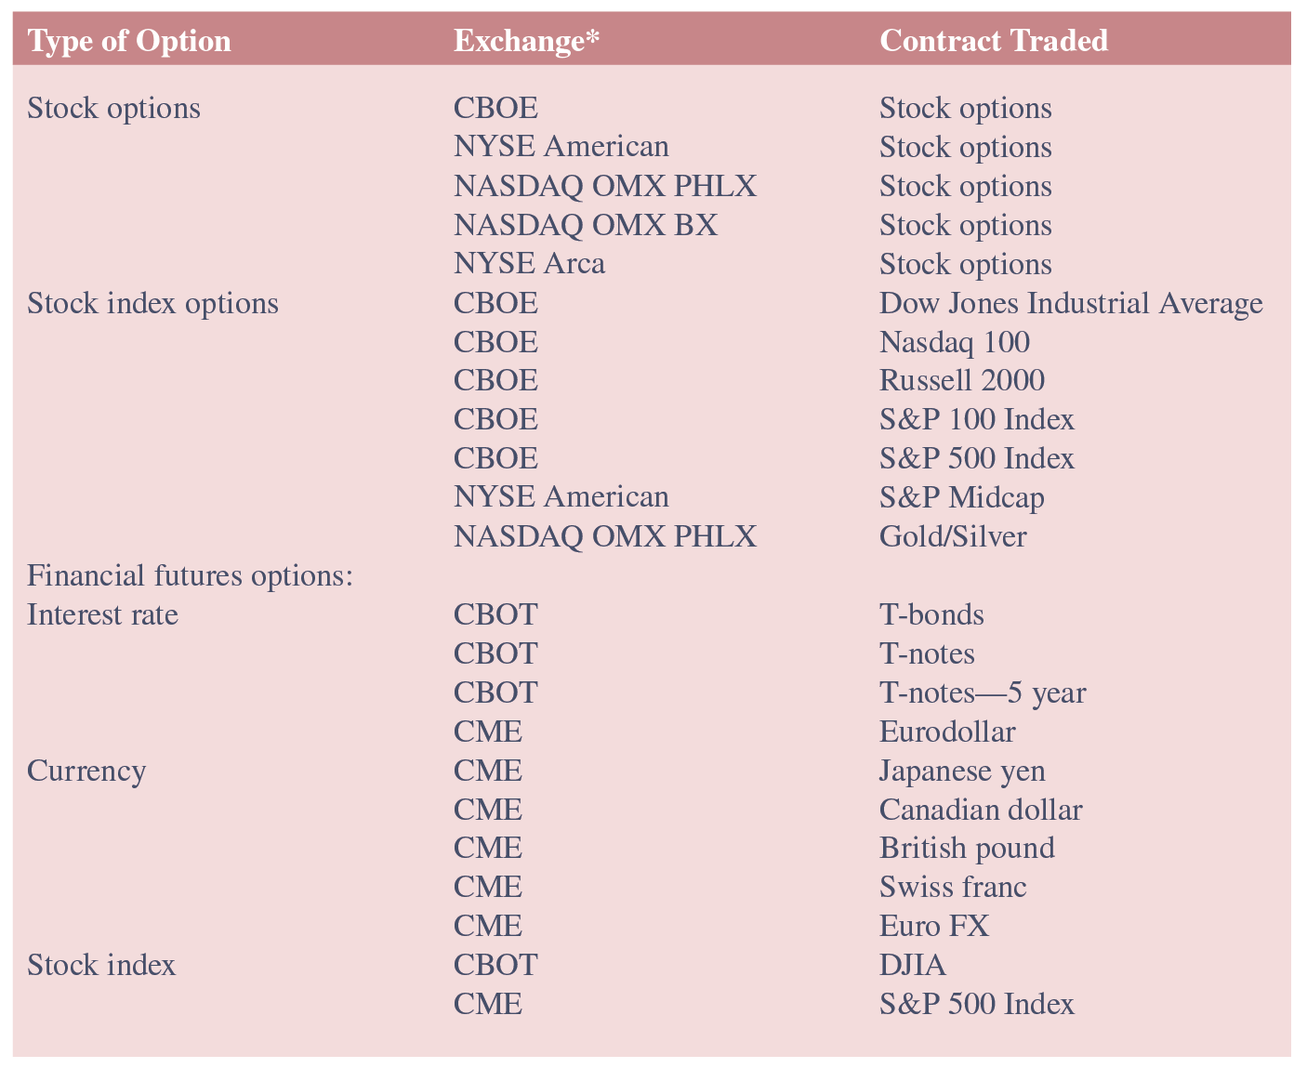
Characteristics of Actively Traded Options

Slide 23
Options Concluded
The underlying asset on a stock option is the stock of a publicly traded company
The underlying asset on a stock index option is the value of a major stock market index (e.g., DJIA or S&P 500)
The underlying asset on a futures option is a futures contract
Two alternative credit option derivatives exist to hedge credit risk on a balance sheet:
  A credit spread call option’s payoff increases as the (default) risk premium or yield spread on a specified benchmark bond of the borrower increases above some exercise spread
  A digital default option pays a stated amount in the event of a loan default

Slide 24
Regulation of Futures and Options Markets
Derivative securities are subject to three levels of institutional regulation
  Regulators of derivatives specify “permissible activities” that institutions may engage in
  Once permissible activities have been specified, institutions engaging in those activities are subjected to supervisory oversight
  Regulators attempt to judge the overall integrity of each institution engaging in derivative activities by assessing the capital adequacy of the institutions and by enforcing regulations to ensure compliance with those capital requirements

Slide 25
Swaps
A swap is an agreement between two parties to exchange a series of cash flows for a specific period of time at a specified interval
  First developed in 1981 when IBM and the World Bank entered into a currency swap agreement
An interest rate swap is an exchange of fixed-interest payments for floating-interest payments by two counterparties
  Allows the swap parties to put in place long-term protection against interest rate risk
  The swap buyer makes the fixed-rate payments in an interest rate swap transaction
  The swap seller makes the floating-rate payments in an interest rate swap transaction

Slide 26
Swaps (Continued)
A currency swap is a swap used to hedge against exchange rate risk from mismatched currencies on assets and liabilities
Credit swaps (i.e., credit default swaps) were developed to better allow FIs to hedge their credit risk
  Total return swap involves swapping an obligation to pay interest at a specified fixed or floating rate for payments representing the total return on a loan of a specified amount
  Pure credit swaps remove the “interest rate”-sensitive element of total return swaps, and are similar to buying credit insurance and/or a multi-period credit option

Slide 27
Swap Markets
Swaps are not standardized contracts
  Generally heterogeneous in terms of maturities, indexes used to determine payments, and timing of payments
Swap dealers (usually FIs) keep markets liquid by matching counterparties or by taking positions themselves
Unlike futures and options markets, swap markets were historically governed by very little regulation
  Because of the role credit swaps played in the financial crisis, the call for stricter regulation over these securities was strong in late 2008 and early 2009

Slide 28
Caps, Floors, and Collars
Caps, floors, and collars are derivative securities that have many uses, especially in helping an FI to hedge interest rate risk
A cap is a call option on interest rates, often with multiple exercise dates
  Equivalent to buying a call option on interest rates
A floor is a put option on interest rates, often with multiple exercise dates
  Similar to buying a put option on interest rates
A collar is a position taken simultaneously in a cap and a floor (e.g., buying a cap and selling a floor)

Slide 29
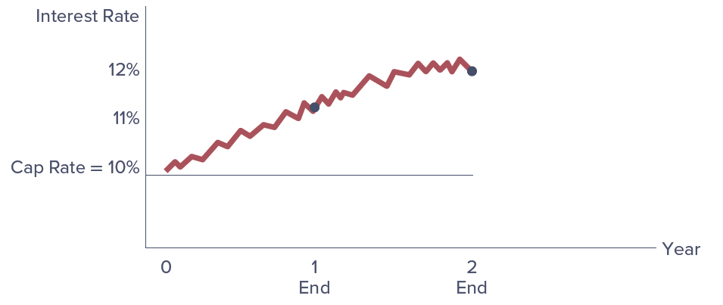
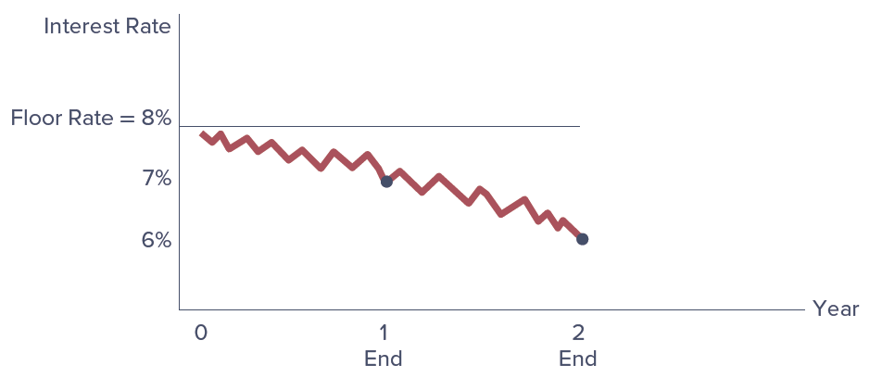
Hypothetical Path of Interest Rates
Cap Agreement
Floor Agreement

Slide 30
International Aspects of Derivative Securities Markets
Between 1999 – 2021, global OTC trading far outweighed exchange trading
  In both markets, interest rate contracts dominated
Markets were heavily impacted as a result of the financial crisis of 2008
U.S. markets and currencies dominate global derivative securities markets
  The euro and European derivative securities markets are a strong second (and, in some areas, exceed that of the U.S.)

